Slide 1
Election Data: Where To Find It, and How To Use It
Presented by Justin Butler
Organizing Director, Maryland Democratic Party
JButler@MDDems.org

Slide 2
Overview
In this training, we will:
Review how to access data available through the Maryland Board of Elections
Learn how to read this data
Utilize this data to calculate a “Win Number”
Review VAN’s data inflow / outflow procedure
Understand how VAN expands upon publicly available information for more efficient and effective organizing

Slide 3
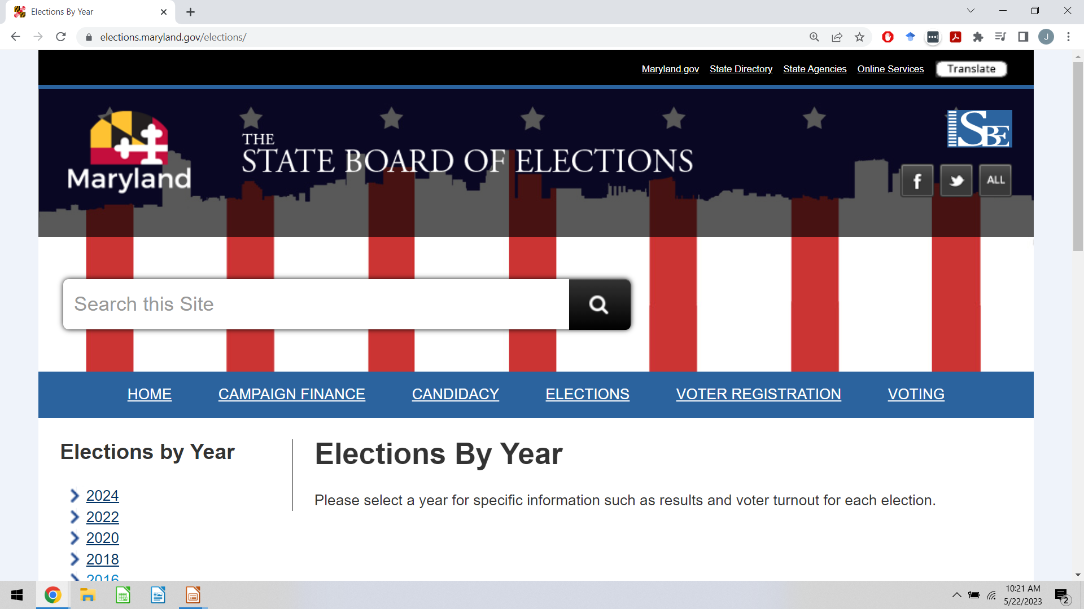
How To Find BoE Data
To begin, start your data dive at: https://www.elections.maryland.gov/elections/

Slide 4
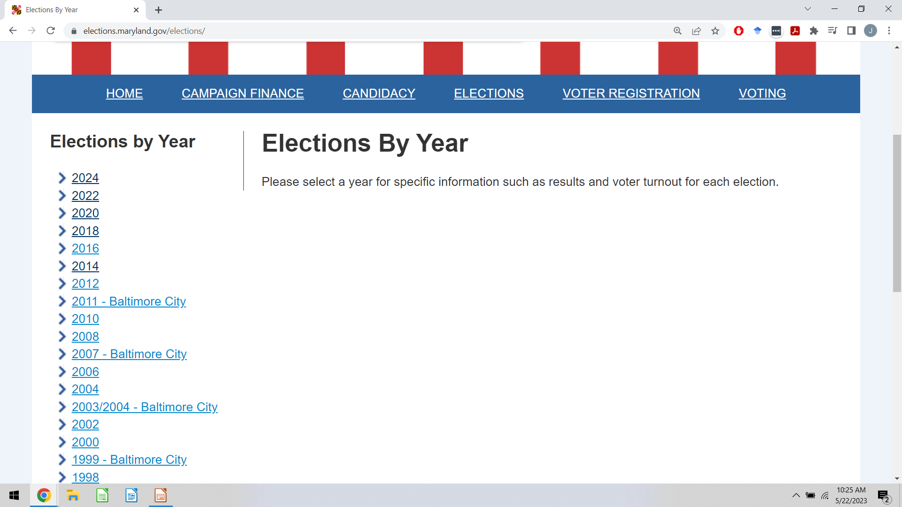
Election Results
Select the election year you are seeking data on: -->

Slide 5
Election Results
From the individual year page, you can find the following:
General and Primary Election results by vote method OR County
Data files for General and Primary Election results by County OR Precinct
Let’s take a guided tour….

Slide 6
Turnout Data
What is turnout data?
What is turnout data useful for?
Find the data tables at: https://www.elections.maryland.gov/press_room/
Find the election year you are seeking, and click the drop down menu for the relevant “Election Report”
Let’s take a tour of the data…..

Slide 7
Using Public Data To Determine Your “Win Number”
What is a “Win Number?”
Art, not science
50% + 1 (But always plan a cushion)
How to calculate your “Win Number”
Determine how many votes would have been required to win in the last 3 elections for that office (50% + 1)
Add those 3 election’s 50% + 1 together, then divide by 3
Note: You can overlay turnout data on election results to make a more accurate model, but that method is far more complex

Slide 8
Using Public Data To Determine Your “Win Number”
Example - 2022 Governor’s Race:
Based on this simple model, we would have expected 982,595 voters to come out in 2022, with a win number of 491,297
Actual 2022 Vote Total: 1,002,612
Actual 2022 Win Number: 501,306 – 2% off
Governor | Total Votes | 50% + 1
2010 | 928,940 | 464,470
2014 | 866,589 | 433,294
2018 | 1,152,256 | 576,128

Slide 9
Voter Activation Network - (VAN)
Mikayla Salazar, MDP Voter File Manager
MSalazar@MDDems.org
What is VAN?
Who gets VAN?
Uses of VAN

Slide 10
Voter Activation Network - (VAN)
Problems VAN overcomes:
Provides current, and historical, data
Redistricting
Data overload
Data point storage
Data point sharing
Converting data into organizing
Mapping
Direct Voter Contact application capability

Slide 11
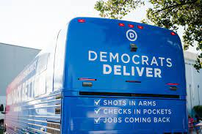
Thanks For Your Time!
Feel free to reach out with questions, or to get involved, at JButler@MDDems.org

